Slide 1

WELCOME TO
Spring 2022-2023

Slide 2
Supervised By DR. MOHAMMAD ALIF ARMAN
Group No:2 Section:[U]
MD RIFAT ALI | 22-46131-1
MD ASIKUR RAHMAN TAJ | 22-46284-1
FARJANA YESMIN OPI | 22-47018-1
SUMAIYA SHARMEEM | 22-46501-1
RUBAET RAZ RISHAD | 22-46377-1

Slide 3
Abstract:
This project presents the design of a BJT amplifier using voltage-divider bias. The amplifier is based on a common emitter topology and uses a voltage-divider circuit to bias the BJT transistor for stable operation. The design process includes selecting a suitable BJT transistor, choosing appropriate resistor values for the voltage-divider circuit, and calculating the values of the coupling and bypass capacitors to achieve the desired gain. The project also includes simulation results and practical considerations for implementing the voltage-divider bias amplifier circuit.

Slide 4
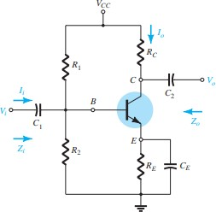
Theory and Methodology
Voltage-divider bias is a method of biasing a BJT transistor in an amplifier circuit. A voltage divider network of two resistors is used to provide the base bias voltage, with the base resistor being much larger than the emitter resistor for stability. The emitter resistor provides negative feedback and stabilizes the DC bias point.
Figure 1: Voltage-Divider Configuration standard structure.

Slide 5
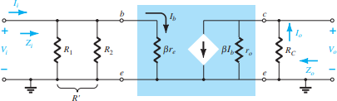


Figure 2: There equivalent circuit in the ac equivalent network. [2]
Voltage-divider bias provides a stable DC bias point for BJT, less sensitive to temperature and transistor variations. Amplifier voltage gain is determined by the collector resistor and transistor transconductance. The emitter resistor stabilizes the operating point and provides negative feedback. Widely used due to stability and ease of implementation, but resistor values must be selected carefully. Simulation/testing is necessary to verify performance and identify issues.
Voltage gain obtained,

Slide 6
Apparatus
N-P-N Transistor BD135G (1).
Capacitor 10µF (2).
Capacitor 100µF (1).
Resistor 33 kΩ (1), 3.3 kΩ (1), 1.5 kΩ (1), 330 Ω (1), 15 kΩ.
DC power supply (100V).
Function generator.
Oscilloscope.

Slide 7
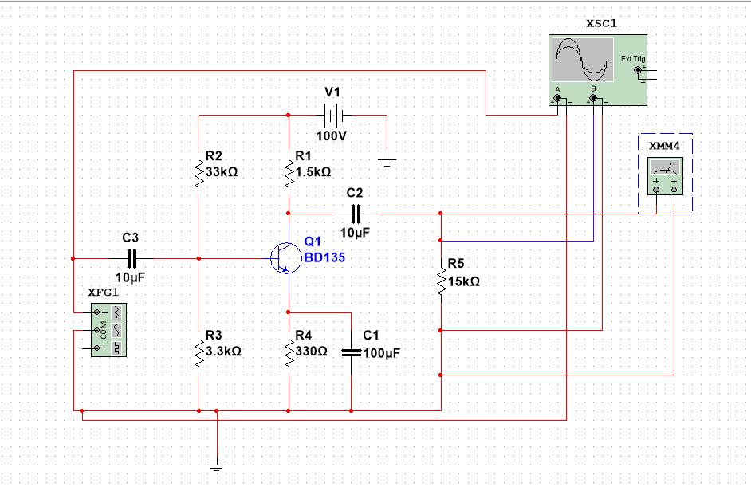
Figure 3: Voltage-Divider Bias circuit.

Slide 8
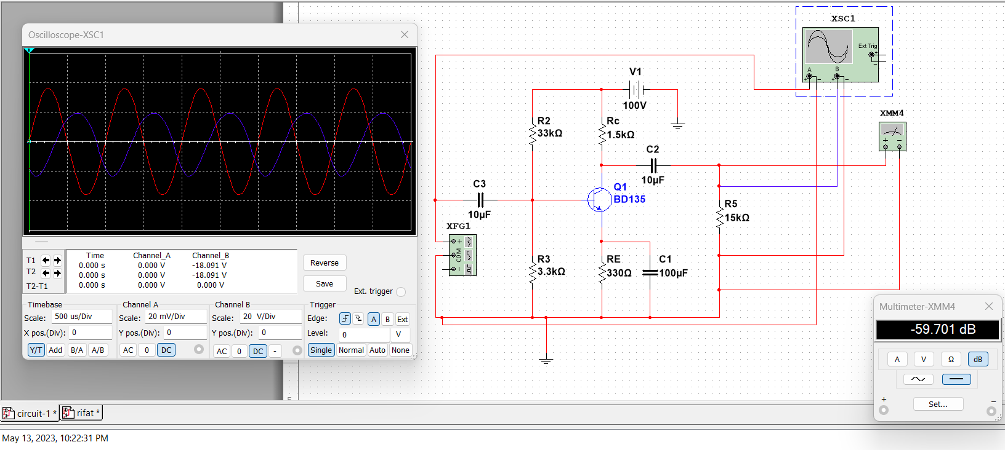
Simulation:
Figure 4: Input and Output signal displayed on the oscilloscope.

Slide 9
Result:
The voltage gain level is 59.701dB.
Discussion:
Select an appropriate BJT and components.
Biasing voltage should be set properly and it need to be half of the dc supply.
The amplifier circuit should be designed with care to ensure stable voltage regulation and protection against overvoltage or undervoltage conditions

Slide 10
References:
American International University–Bangladesh (AIUB) Electronic Devices Lab Manual.
Robert Boylestad & Louis Nashelky, “Electronics Devices & Circuit Theory”, 11th edition, Prentice Hall.

Slide 11
THANK YOU

